Slide 1

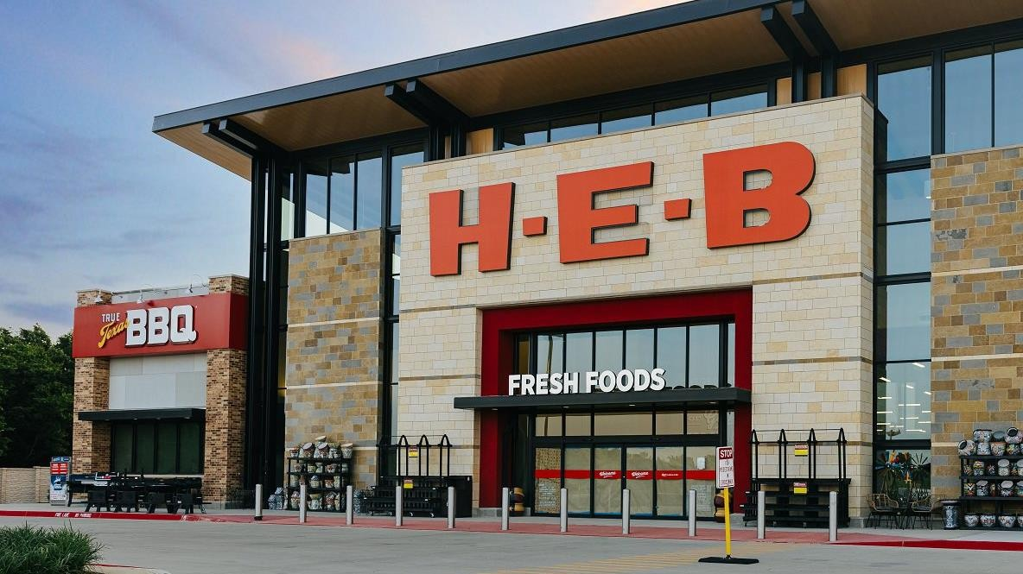

Weekly Status Report
Cost, Supplier, Pricing, Wentworth, Location,
Pharmacy, GSS and PAM HEBXXX-SUST-0002-00
11 July, 2025
PROPRIETARY & CONFIDENTIAL © G10X (2025) HEBXXX-SUST-0002-00

Slide 2

Index
TABLE OF CONTENTS
03 Cost Core Service CHEDR (Haskell) | 04 Supplier Core Service QA and SPUR (Haskell) | 07 Pricing Core Service (Haskell and Java)
08 Wentworth (Haskell) | 09 Location Core Service (Java and Angular) | 10 Pharmacy and Wellness (iOS and QA)
12 Global Sourcing Solution | 13 Product Attribute Management (QA) | 14 LoCo (BSA)
15 Matters of Attention | 15 Team Allocation

Slide 3
Delivery Status – { Track Name}
Highlights of week ending { Week End Date } | Overall status
 | Last Week | This Week
Sprint – { Sprint Name }, { Status } ({ From Date } – { To Date }) Stories (Total – { Count }, Completed – { Count }, In-Progress – { Count }, In-Review – { Count }) Current week sprint status Stories completed this week – { Completed Count } stories { Completed Story Title } Stories released for Partner review – { In-Review Count } stories { In-Review Story Title } Stories in-progress this week – { In-Progress Count } stories { In-Progress Story Title }
Key activities for next week
{ In-Progress Story Title }

Slide 4
Delivery Status
Matters of Attention | Overall status
 | Last Week | This Week
None to Report
Team Allocation
# | Name | Skillset | Track | Billable Count
1 | Karthic Kumar | Haskell | Supplier Core Service | 2
2 | Akash Verma
3 | Rishi Manoj | Haskell | Cost Core Service | 4
4 | Arjun P Khandkar
5 | Althaf Hussain
6 | SparshTandon
7 | Nishant Kaushik | Haskell | Wentworth | 1
8 | Vijai Krishna | Haskell | Pricing Core Service | 1
9 | Imthiyaz A S | QA Automation | Supplier Portal | 2
10 | Balu S Kumar
11 | Vineed Kaladharan | AngularJS | Location Core Service | 3
12 | Noblevincent Vincent | Java
13 | Vignesh Krishnan
14 | Arshana Kizhakkiniyakath | QA | Pharmacy & Wellness | 3
15 | Remya Karuppayil
16 | Gisha Sankaran
17 | Kumar K Singh | AngularJS | Own Brand Product System | 1
18 | Vinu Lalitha | QA | Product Attribute Management | 1
19 | Sifat Billah Chowdhury | BSA | All COST Services / Locations | 1
20 | Shivaraj Kumarappa | Delivery Lead | All Tracks | 1
Total |  |  |  | 20

Slide 5


WWW.G10X.COM
G10X Inc.
7545 Irvine Center Drive Irvine, California
USA
G10X Technology Pvt Ltd. Brigade World Trade Center Infopark, Cochin
India
G10X Pvt Ltd.
Berkeley Square House London, W1J 6BD
UK
G10X GmbH
Mergenthalerallee 10 Eschborn, Frankfurt
Germany
G10X PTE Ltd.
Prudential Tower Singapore 049712
Singapore
G10X DMCC
Gold Tower DMCC, Dubai
UAE
PROPRIETARY & CONFIDENTIAL © G10X (2025) HEBXXX-SUST-0002-00

